Slide 1
Lecture 3
Math Foundations Team

Slide 3
Analytic geometry
We have studied vector spaces in the previous lecture.
Now we would like to provide some geometric interpretation to these concepts.
We shall take a close look at geometric vectors and the concepts of lengths of vectors and angles between vectors.
But first we need to add the concept of an inner product to our vector space.

Slide 4
Motivation to study the distance between vectors
First let us introduce Similarity and Dissimilarity between data Objects:
Similarity is a numerical measure of how alike two data objects are
Value is higher when data objects are more alike
Often falls in the range of [0,1] (Otherwise one can normalize)
Dissimilarity is a numerical measure of how different two data objects are
Lower when objects are more alike
Minimum dissimilarity is 0
Upper limits varies

Slide 5
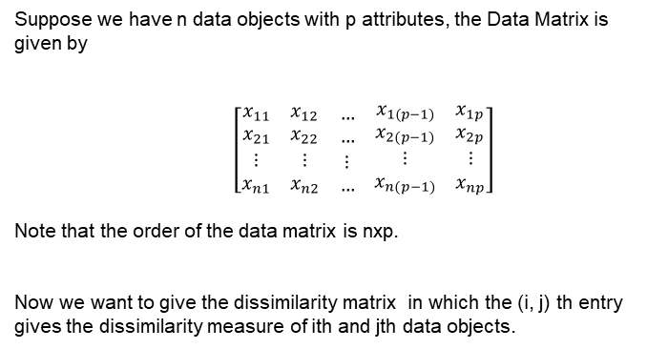
The Data Matrix and Dissimilarity matrix
Suppose we have n data objects with p attributes, the Data Matrix is given by
$\left[\begin{matrix}\begin{matrix}x_{11} & x_{12}\end{matrix} & … & \begin{matrix}x_{1(p−1)} & x_{1p}\end{matrix} \\ \begin{matrix}x_{21} & x_{22}\end{matrix} & … & \begin{matrix}x_{2(p−1)} & x_{2p}\end{matrix} \\ \begin{matrix}\begin{matrix}⋮ \\ x_{n1}\end{matrix} & \begin{matrix}⋮ \\ x_{n2}\end{matrix}\end{matrix} & \begin{matrix}⋮ \\ …\end{matrix} & \begin{matrix}\begin{matrix}⋮ \\ x_{n(p−1)}\end{matrix} & \begin{matrix}⋮ \\ x_{np}\end{matrix}\end{matrix}\end{matrix}\right]$
Note that the order of the data matrix is nxp.
Now we want to give the dissimilarity matrix in which the (i, j) th entry gives the dissimilarity measure of ith and jth data objects.
Data Objects
x₁
x₂
x_{n}
Attributes

Slide 6
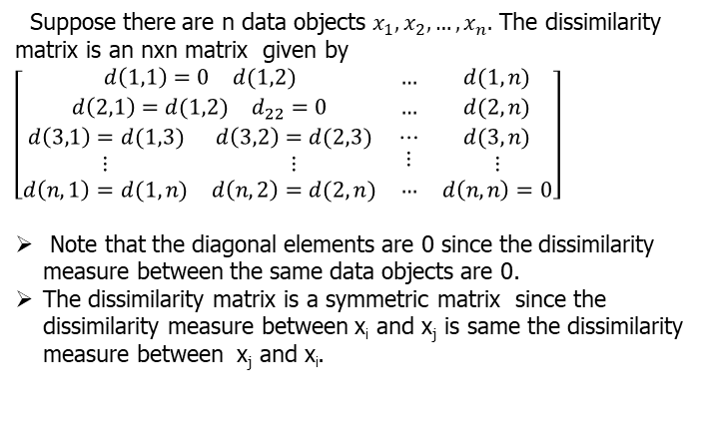
Dissimilarity Matrix
Suppose there are n data objects $x_{1}, x_{2}, …, x_{n}.$ The dissimilarity matrix is an nxn matrix given by
$\left[\begin{matrix}\begin{matrix}d\left(1,1\right)=0 & d(1,2)\end{matrix} & … & d(1,n) \\ \begin{matrix}d\left(2,1\right)=d(1,2) & d_{22}=0\end{matrix} & … & d(2,n) \\ \begin{matrix}d\left(3,1\right)=d(1,3) & d\left(3,2\right)=d(2,3) \\ \begin{matrix}⋮ \\ d\left(n,1\right)=d(1,n)\end{matrix} & \begin{matrix}⋮ \\ d\left(n,2\right)=d(2,n)\end{matrix}\end{matrix} & \begin{matrix}⋯ \\ \begin{matrix}⋮ \\ …\end{matrix}\end{matrix} & \begin{matrix}d(3,n) \\ \begin{matrix}⋮ \\ d\left(n,n\right)=0\end{matrix}\end{matrix}\end{matrix}\right]$
Note that the diagonal elements are 0 since the dissimilarity measure between the same data objects are 0.
The dissimilarity matrix is a symmetric matrix since the dissimilarity measure between x_{i} and x_{j} is same the dissimilarity measure between x_{j} and x_{i}.

Slide 7
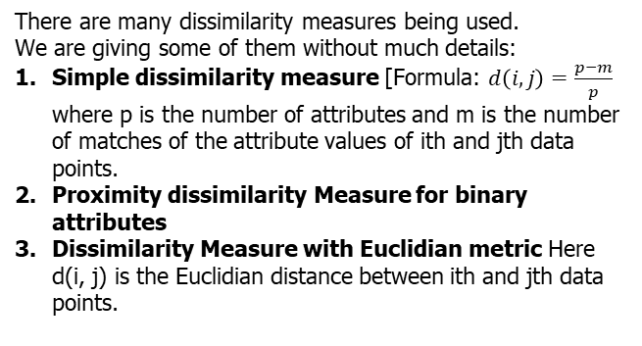
Dissimilarity Measures
There are many dissimilarity measures being used.
We are giving some of them without much details:
Simple dissimilarity measure [Formula: $d\left(i,j\right)=\frac{p−m}{p}$ where p is the number of attributes and m is the number of matches of the attribute values of ith and jth data points.
Proximity dissimilarity Measure for binary attributes
Dissimilarity Measure with Euclidian metric Here d(i, j) is the Euclidian distance between ith and jth data points.

Slide 8
Example of a dissimilarity matrix with Euclidian distance
Suppose our data matrix of four data objects is given by
Data Object | Attribute 1 | Attribute 2
x₁ | 1 | 2
x₂ | 3 | 5
x₃ | 2 | 0
x₄ | 4 | 5

Slide 9
Example of a dissimilarity matrix with Euclidian distance
 | x₁ | x₂ | x₃ | x₄
x₁ | 0 | 3.61 | 2.24 | 4.24
x₂ | 3.61 | 0 | 5.1 | 1
x₃ | 2.24 | 5.1 | 0 | 5.39
x₄ | 4.24 | 1 | 5.39 | 0

Slide 10
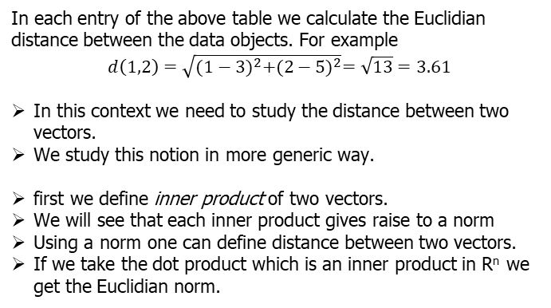
Example Ctd
In each entry of the above table we calculate the Euclidian distance between the data objects. For example
$$d\left(1,2\right)=\sqrt{{(1−3)}^{2}+{(2−5)}^{2}}=\sqrt{13}=3.61$$
In this context we need to study the distance between two vectors.
We study this notion in more generic way.
first we define inner product of two vectors.
We will see that each inner product gives raise to a norm
Using a norm one can define distance between two vectors.
If we take the dot product which is an inner product in R^{n} we get the Euclidian norm.

Slide 11
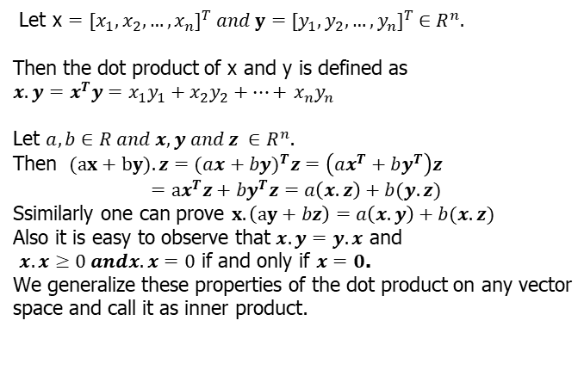
Dot product in R^{n}
Let x $={[x_{1}, x_{2}, …, x_{n}]}^{T} and y={[y_{1}, y_{2}, …, y_{n}]}^{T} ∈R^{n}.$
Then the dot product of x and y is defined as
$x.y=x^{T}y=x_{1}y_{1}+x_{2}y_{2}+…+$ $x_{n}y_{n}$
Let $a,b∈R and x,y and z ∈R^{n}$.
Then $(ax+by).z=(a{x+by)}^{T}z=\left(ax^{T}+by^{T}\right)z$
$$=ax^{T}z+by^{T}z=a\left(x.z\right)+b(y.z)$$
Ssimilarly one can prove $x.\left(ay+bz\right)=a\left(x.y\right)+b(x.z)$
Also it is easy to observe that $x.y=y.x$ and
$x.x≥0 andx.x=0$ if and only if $x=0$.
We generalize these properties of the dot product on any vector space and call it as inner product.

Slide 12
Definitions: Bilinear Mapping, Symmetric Mapping and Positive Definite Mapping
A bilinear mapping Ω is a mapping with two arguments and is linear in both arguments: Let V be a vector space such that x , y , z ∈ V , and let λ, ψ ∈ R. Then we have
Ω(λx + ψy , z) = λΩ(x , z) + ψΩ(y , z), and
Ω(x , λy + ψz) = λΩ(x , y) + ψΩ(x , z).
Let V be a vector space and Ω : V × V → R be a bilinear mapping that takes two vectors as arguments and returns a real number. Then Ω is called symmetric if
Ω(x , y) = Ω(y , x). Also Ω is called positive-definite if
∀x ∈ V \ {0}, Ω(x , x) > 0 and Ω(0, 0) = 0.

Slide 13
Inner products
A positive-definite, symmetric bilinear mapping
Ω : V × V → R is called an inner product. To denote an inner product on V we generally write ⟨x , y⟩.
The pair (V , ⟨., .⟩) is called an inner product space.
Next we introduce the concept of symmetric, positive-definite matrices and show we can express an inner product using such matrices.
We recall that in a vector space V any vector x can be written as linear combination of the basis vectors. We use this to express an inner product in terms of a matrix.

Slide 14
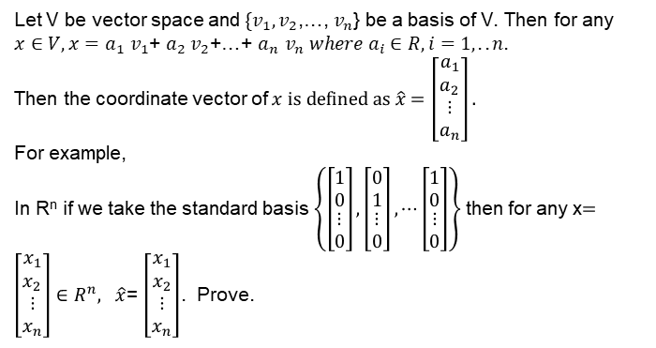
Notation for coordinates
Let V be vector space and $\{v_{1},v_{2}$,…, $v_{n}$} be a basis of V. Then for any $x∈V, x=a_{1}$ $v_{1}$+ $a_{2}$ $v_{2}$+…+ $a_{n}$ $v_{n} where a_{i}∈R, i=1,..n.$
Then the coordinate vector of $x is defined as \hat{x}=\left[\begin{matrix}a_{1} \\ a_{2} \\ \begin{matrix}⋮ \\ a_{n}\end{matrix}\end{matrix}\right].$
For example,
In R^{n} if we take the standard basis $\left\{\left[\begin{matrix}1 \\ 0 \\ \begin{matrix}⋮ \\ 0\end{matrix}\end{matrix}\right],\left[\begin{matrix}0 \\ 1 \\ \begin{matrix}⋮ \\ 0\end{matrix}\end{matrix}\right],⋯\left[\begin{matrix}1 \\ 0 \\ \begin{matrix}⋮ \\ 0\end{matrix}\end{matrix}\right]\right\}$then for any x$=\left[\begin{matrix}x_{1} \\ x_{2} \\ \begin{matrix}⋮ \\ x_{n}\end{matrix}\end{matrix}\right]∈R^{n}, \hat{x}$= $\left[\begin{matrix}x_{1} \\ x_{2} \\ \begin{matrix}⋮ \\ x_{n}\end{matrix}\end{matrix}\right]$. Prove.

Slide 15
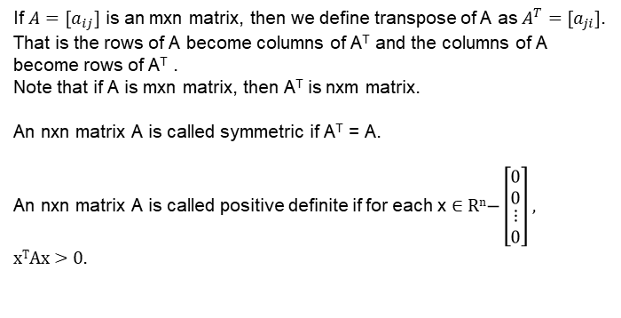
Symmetric Matrices and Positive Definite Matrices
If $A=[a_{ij}]$ is an mxn matrix, then we define transpose of A as $A^{T}=[a_{ji}]$.
That is the rows of A become columns of A^{T} and the columns of A become rows of A^{T} .
Note that if A is mxn matrix, then A^{T} is nxm matrix.
An nxn matrix A is called symmetric if A^{T} = A.
An nxn matrix A is called positive definite if for each x ∈ R^{n}$−\left[\begin{matrix}0 \\ 0 \\ \begin{matrix}⋮ \\ 0\end{matrix}\end{matrix}\right]$ , x^{T}Ax > 0.

Slide 16
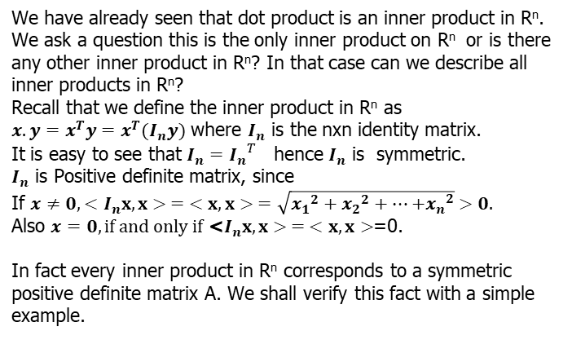
Relooking at Dot Product in R^{n}
We have already seen that dot product is an inner product in R^{n}.
We ask a question this is the only inner product on R^{n} or is there any other inner product in R^{n}? In that case can we describe all inner products in R^{n}?
Recall that we define the inner product in R^{n} as
$x.y=x^{T}y=x^{T}(I_{n}y)$ where $I_{n}$ is the nxn identity matrix.
It is easy to see that $I_{n}={I_{n}}^{T}$ hence $I_{n}$ is symmetric.
$I_{n}$ is Positive definite matrix, since
If $x≠0, <$ $I_{n}x, x> = <x, x> =\sqrt{{x_{1}}^{2}+{x_{2}}^{2}+…{+x_{n}}^{2}} >0.$
Also $x=0, \text{if} \text{and} \text{only} \text{if} \text{<}I_{n}x, x> = <x, x>$=0.
In fact every inner product in R^{n} corresponds to a symmetric positive definite matrix A. We shall verify this fact with a simple example.

Slide 17
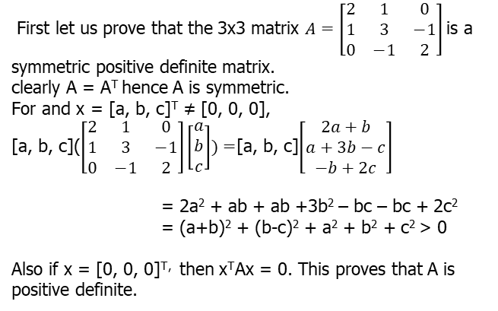
Example
First let us prove that the 3x3 matrix $A=\left[\begin{matrix}2 & 1 & 0 \\ 1 & 3 & −1 \\ 0 & −1 & 2\end{matrix}\right]$is a symmetric positive definite matrix.
clearly A = A^{T} hence A is symmetric.
For and x = [a, b, c]^{T} ≠ [0, 0, 0],
[a, b, c]($\left[\begin{matrix}2 & 1 & 0 \\ 1 & 3 & −1 \\ 0 & −1 & 2\end{matrix}\right]\left[\begin{matrix}a \\ b \\ c\end{matrix}\right])=$[a, b, c]$\left[\begin{matrix}2a+b \\ a+3b−c \\ −b+2c\end{matrix}\right]$
= 2a² + ab + ab +3b² – bc – bc + 2c²
= (a+b)² + (b-c)² + a² + b² + c² > 0
Also if x = [0, 0, 0]^{T,} then x^{T}Ax = 0. This proves that A is positive definite.

Slide 18
Example(Ctd)
Now the inner product in R^{n} using this matrix A can be defined as <x, y> = X^{T}(Ay).
Proof:
< > is symmetric since <x, y> = X^{T}(Ay) = [X^{T}(Ay)]^{T} (Since <x, y> is a real number) = (Ay)^{T} X = (y^{T}A^{T})x = (y^{T}A)x = y^{T}(Ax) = <y, x> [The last two steps follow since A is symmetric and matrix multiplication is associative.]
<(ax+by) , z> = (ax +by)^{T} Az = (ax^{T}+ by^{T})Az
= a(x^{T}Az) + b(y^{T}Az)
= a<x, z> + b<y, z>
Similarly one can prove
<x, ay + bz> = a<x, y> + b<y, z>

Slide 19
Now <x, x> = x^{T}Ax > 0 if x ≠ 0. Since A is positive definite.
Also <x, x> = 0 if and only if x = 0.
Converse of this result is also true, namely if < > is an inner product on R^{n} then there exists a nxn symmetric positive definite matrix A such that <x, y> = x^{T}Ay.
This theorem can be generalized for any general metric space V which we sate and prove in the following slides.

Slide 20
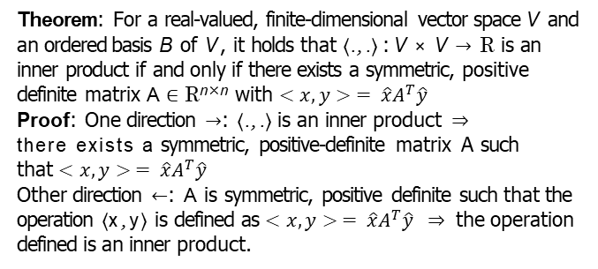
Symmetric, positive-definite matrices
Theorem: For a real-valued, finite-dimensional vector space V and an ordered basis B of V , it holds that ⟨., .⟩ : V × V → R is an inner product if and only if there exists a symmetric, positive definite matrix A ∈ R^{n×n} with $<x, y> = \hat{x}A^{T}\hat{y}$
Proof: One direction →: ⟨., .⟩ is an inner product ⇒ there exists a symmetric, positive-definite matrix A such that $<x, y> = \hat{x}A^{T}\hat{y}$
Other direction ←: A is symmetric, positive definite such that the operation ⟨x , y⟩ is defined as $<x, y> = \hat{x}A^{T}\hat{y} ⇒$ the operation defined is an inner product.

Slide 21
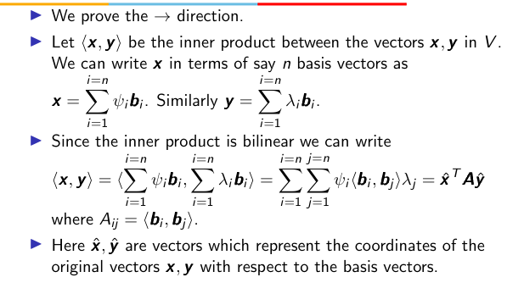
Proof (Ctd)

Slide 22
Proof (Ctd)
This means that the inner product is entirely determined through the matrix A. The symmetry of the inner product means that A_{ij} = ⟨b_{i}, b_{j} ⟩ = A_{ji} = ⟨b_{j}, b_{i} ⟩. Thus A is symmetric.
The positive-definiteness of the inner product means that
∀x ∈ V \{0}, x ^{T} Ax > 0.

Slide 23
Proof(Ctd)
Now let us consider an operation op such that x opy = xˆ^{T} Ayˆ where A is a symmetric, positive definite matrix.
We shall show that ”op” is an inner product by showing that it has all the properties of an inner product:
”op” has symmetry because x opy = xˆ^{T} Ayˆ and
y opx = yˆ^{T} Axˆ = yˆ^{T} (Axˆ). By a property of the dot product we can write yˆ^{T} (Axˆ) = (Axˆ)^{T} yˆ = xˆ^{T} A^{T} yˆ = xˆ^{T} Ayˆ where the last equality in the chain is possible since A is symmetric.

Slide 24
Proof(Ctd)
”op” also has bilinearity since we see that for
r ∈ R, (r x)opy = (r xˆ)^{T} Ayˆ = r xˆ^{T} Ayˆ = r (x opy).
Similarly we can prove r ∈ R, xop(ry)
(x + y)opz = (xˆ + yˆ)^{T} Azˆ = xˆ^{T} Azˆ + yˆ^{T} Azˆ = x opz + y opz.
Finally if x is a non-zero vector then xˆ is also a non-zero vector, x opx = xˆ^{T} Axˆ > 0 since we are given that A is positive-definite.

Slide 25
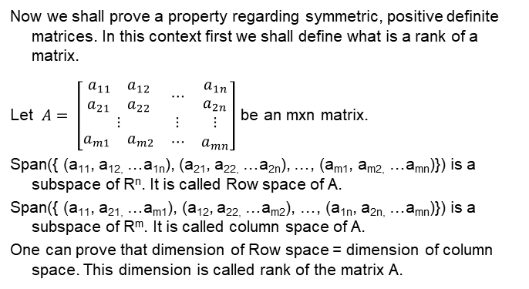
Rank of a Matrix
Now we shall prove a property regarding symmetric, positive definite matrices. In this context first we shall define what is a rank of a matrix.
Let $A= \left[\begin{matrix}\begin{matrix}\begin{matrix}a_{11} \\ a_{21}\end{matrix} & \begin{matrix}a_{12} \\ a_{22}\end{matrix}\end{matrix} & ⋯ & \begin{matrix}a_{1n} \\ a_{2n}\end{matrix} \\ ⋮ & ⋮ & ⋮ \\ \begin{matrix}a_{m1} & a_{m2}\end{matrix} & ⋯ & a_{mn}\end{matrix}\right]$ be an mxn matrix.
Span({ (a₁₁, a_{12,} …a_{1n}), (a₂₁, a_{22,} …a_{2n}), …, (a_{m1}, a_{m2,} …a_{mn})}) is a subspace of R^{n}. It is called Row space of A.
Span({ (a₁₁, a_{21,} …a_{m1}), (a₁₂, a_{22,} …a_{m2}), …, (a_{1n}, a_{2n,} …a_{mn})}) is a subspace of R^{m}. It is called column space of A.
One can prove that dimension of Row space = dimension of column space. This dimension is called rank of the matrix A.

Slide 26
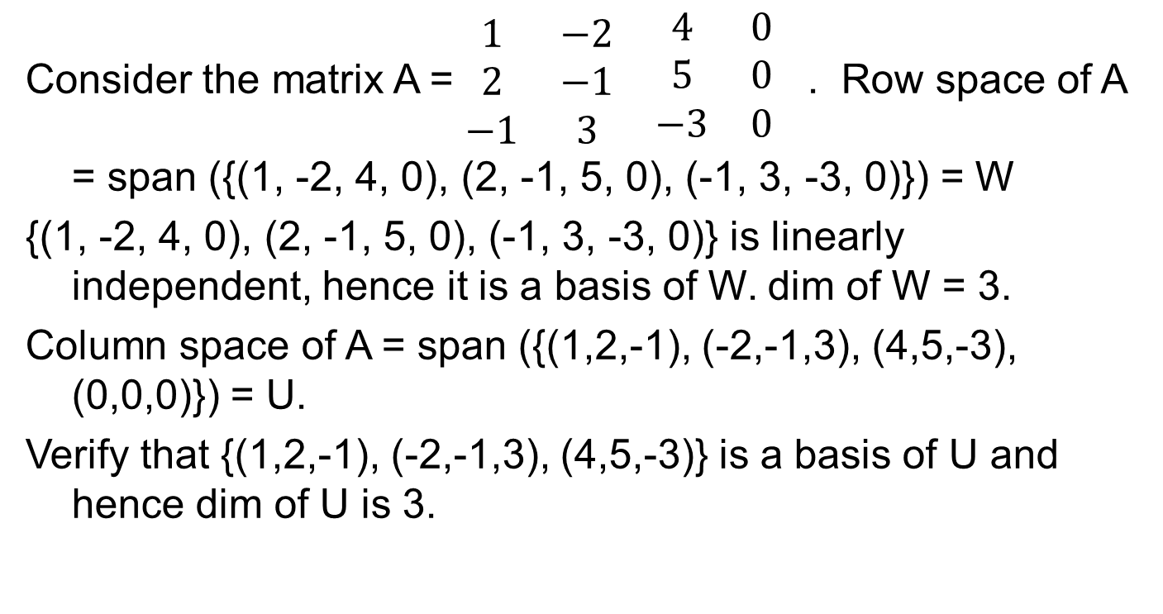
Example
Consider the matrix A = $\begin{matrix}\begin{matrix}1 & −2 \\ 2 & −1 \\ −1 & 3\end{matrix} & \begin{aligned}\begin{matrix}4 & 0 \\ 5 & 0 \\ −3 & 0\end{matrix} \\ \end{aligned}\end{matrix}$ . Row space of A = span ({(1, -2, 4, 0), (2, -1, 5, 0), (-1, 3, -3, 0)}) = W
{(1, -2, 4, 0), (2, -1, 5, 0), (-1, 3, -3, 0)} is linearly independent, hence it is a basis of W. dim of W = 3.
Column space of A = span ({(1,2,-1), (-2,-1,3), (4,5,-3), (0,0,0)}) = U.
Verify that {(1,2,-1), (-2,-1,3), (4,5,-3)} is a basis of U and hence dim of U is 3.

Slide 27
Method to find the rank of a matrix.
Theorem : The nonzero row vectors of a matrix A that is in echelon form is a basis for the row space of A. The rank of A is the number of nonzero row vectors.
These matrices are in echelon form.
Hance rank of the first matrix is 4 and the second matrix is 3.
Theorem: An nxn matrix A has rank n if and only if the homogenous equation AX = 0 has only the trivial solution(in other words the null space of A only 0 vector).

Slide 28
Properties of Symmetric , Positive Definite Matrices
Can a symmetric, positive-definite nxn matrix have rank less than n? We have x ^{T} Ax > 0 for all non-zero x. Thus the homogenous equation Ax = 0 has only a trivial solution. This means in the reduce row echelon form A, each column must have a pivot element. This means there is no zero row in the reduce row echelon form A Hence A must have rank n.
What can be said about the diagonal elements of a
positive-definite matrix? From (e_{i} )^{T} Ae_{i} > 0 where e_{i} is the i th canonical basis vector, we see that A_{ii} > 0. Thus the diagonal entries are all strictly positive.

Slide 29
Norms
A norm on a vector space is a function . : V → R, x → x which assigns to each vector x a length x such that for all λ ∈ R and x , y ∈ V the following properties hold:
Absolutely homogeneous: λx = |λ| x
Triangle inequality: x + y ≤ x + y
Positive definite: x ≥ 0 and x = 0 ⇔ x = 0
i =n
Manhattan norm : x = |x |
Σ
i
i =1
i =n
Euclidean norm : x =
Σ
x ².
2
i
i =1

Slide 30
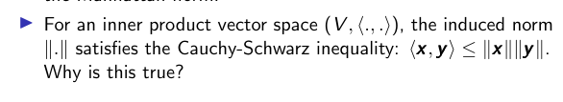
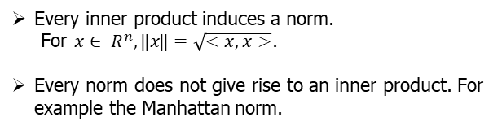
Norms and Inner Products
Every inner product induces a norm.
For $x∈ R^{n}, ⃦x ⃦=\sqrt{<x,x>}$.
Every norm does not give rise to an inner product. For example the Manhattan norm.

Slide 31
Proof of Cauchy-Schwarz inequality
Let u and v be two vectors and let us consider the length of the vector u − αv where α is a constant.
The length of the vector u − αv is greater than or equal to zero. The length of the vector u − αv is
T
u − αv ² = ⟨u − αv , u − αv⟩ = (u − αv) (u −αv).
we can expand the dot product
(u − αv)^{T} (u − αv) = u^{T} u − αu^{T} v − αv ^{T} u + α²v ^{T} v ≥ 0
►
Taking $a=\frac{u^{T}v}{v^{T}v}$we get $|<u,v>|≤ ⃦ u ⃦ ⃦ v ⃦$

Slide 32
Metric space
Consider an inner product space (V , ⟨., .⟩). Define d (x , y) the
distance between two vectors x and y to be
d (x , y) = x − y
If we use the dot product as the inner product, then the distance is called the Euclidean distance.
The mapping d : V × V → R is called a metric.
Problem: With respect the inner product < > defined using a matrix A in slide no 17, find the norm on R^{n} and also the distance between any two vectors in R^{n}

Slide 33
Properties of a metric space
A metric d has the following properties:
d is positive-definite which means d (x , y) ≥ 0 ∀x , y ∈ V .
d (x , y) = 0 =⇒ x = y.
d is symmetric which means d (x , y) = d (y , x) ∀x , y ∈ V .
d obeys the triangle inequality as follows:
d (x , z) ≤ d (x , y) + d (y , z) ∀x , y , z ∈ V
Inner products and metrics seem to be very similar in terms of their properties - however there is one important difference. When x and y are close to each other the inner product is large but the distance metric is small. On the other hand when x and y are far apart, then the inner product is small but the distance metric is large.

Slide 34
Angles and orthogonality
In addition to being able to capture the lengths of vectors and the distance between vectors, inner products can also capture the angle ω between two vectors and can thus capture the geometry of a vector space.
The key to using the inner product to characterize the angle between two vectors is the Cauchy-Schwarz inequality.
Assume that x and y are not the 0 vector. Then the Cauchy-Schwarz inequality tells us that
x ^{T} y
−1 ≤
≤ 1 (1)
x y

Slide 35
Angles and orthogonality
Since the Cauchy-Schwarz ratio lies between -1 and 1 we can set it equal to the cosine of a unique angle ω ∈ [0, π] such that
⟨x , y⟩
cos(ω) = (2)
x y
The angle ω is the angle between two vectors. What does it capture?
The notion of angle captures similarity of orientation between two vectors. When the dot product is close to zero, the vectors are more or less pointing in orthogonal directions and ω ≈ π/2.

Slide 36
Angles and orthogonality
Food for thought: Suppose we choose vectors x and y uniformly at random in high dimensions. What happens to the dot product between the vectors and hence the angle between them?
To choose a vector uniformly at random over a sphere let every component in the vector be an independent Gaussian random variable of mean 0 and unit variance.
Write a small program to see what happens ...

Slide 37
Angles and orthogonality
A key feature of the inner product is that we can use it to characterize vectors that are orthogonal.
Two vectors x and y are orthogonal if and only if the inner product between them is 0. For an orthogonal pair of vectors x, y we can write x ⊥ y.
By the above definition the 0-vector is orthogonal to all vectors.
Vectors which are orthogonal with respect to one inner product need not be orthogonal with respect to another inner product.

Slide 38
Example - angles and orthogonality
Consider the vectors x = [1, 1]^{T} and y = [−1, 1]^{T}
With respect to the inner product defined as a dot product we
see that ⟨x , y⟩ = x ^{T} y = 1 ∗ −1 + 1 ∗ 1 = 0.
2 0
►
With respect to the inner product x
T
y , the angle
0 1
between the two vectors x and y becomes
⟨x , y⟩
cos(ω) =
x y
= -1/3
Hence with respect to this inner product the vectors are no longer orthogonal.

Slide 39
Orthogonal matrix
A square matrix A ∈ R^{n×n} is an orthogonal matrix if and only if its columns are orthonormal:
A^{T} A = I = AA^{T}
_{A}T _{= A}−1
If the columns of a matrix are orthonormal, why are its rows orthonormal too? This follows from the fact that the
left-inverse of a square matrix is the same as the right-inverse. Let A be a square matrix with B and C the left and right inverses of A: BA = I = AC =⇒ B = C. Why is this true?

Slide 40
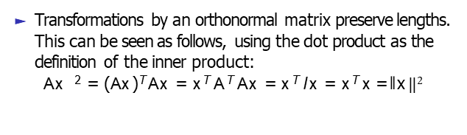
Orthogonal matrix
Transformations by an orthonormal matrix preserve lengths. This can be seen as follows, using the dot product as the definition of the inner product:
Ax ² = (Ax )^{T} Ax = x ^{T} A^{T} Ax = x ^{T} I x = x ^{T} x = ⃦ x $⃦$²
An example of an orthonormal matrix is the 2D-rotation
matrix which can be expressed as the angle of rotation.
cos θ −sinθ
where θ is
sinθ cosθ

Slide 41
Orthogonal matrix
Also the angle between two vectors x and y does not change after transformation by an orthogonal matrix. This can be seen as follows:
(Ax )^{T} Ay
Ax Ay
cos(ω) =
x ^{T} A^{T} Ay x y
x ^{T} y x y
=
=

Slide 42
Orthonormal basis
We already looked at the concept of a basis of a vector space, and found that for the vector space R^{n} we need n basis vectors.
Our basis vectors needed only to be linearly independent - we can ensure linear independence by ensuring that our basis vectors point in different directions, so that a linear combination of n − 1 basis vectors cannot cancel out the nth basis vector.
Now we will look at a special case of a basis where the vectors are all mutually orthogonal in the sense of the inner product, and each vector is of unit length. We call such a basis an orthonormal basis.

Slide 43
Orthonormal basis
Question: Can you immediately think of an orthonormal basis for R^{n}? Is an orthonormal basis for a vector space unique?
Formal definition of an orthonormal basis: Consider an
n-dimensional vector space V and n basis vectors
{b₁, b₂, . . . b_{n}}. If it is true that
∀i, j = 1, . . . n, i ̸= j ⟨b_{i}, b_{j} ⟩ = 0 and ⟨b_{i}, b_{i} ⟩ = 1, then the basis is called an orthonormal basis.
If the basis vectors are only mutually orthogonal but not of length unity, then we have an orthogonal basis.

Slide 44
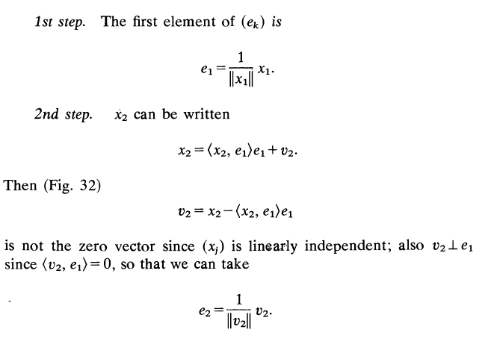
Gram-Schmidt Orthonormalization Method
Given a linarly independent set {x₁, x₂, …. x_{n}} we have to find an orthonormal set {e₁, e₂, … e_{n}} such that span {x₁, x₂, …. x_{n}} = span {e₁, e₂, … e_{n}} .

Slide 45
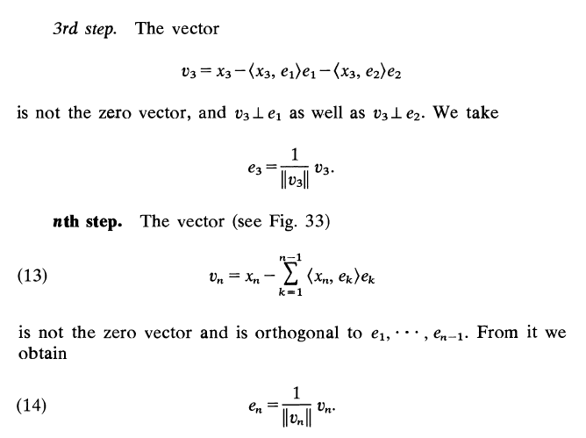
Gram-Schmidt Orthonormalization Method

Slide 46
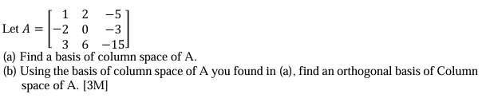
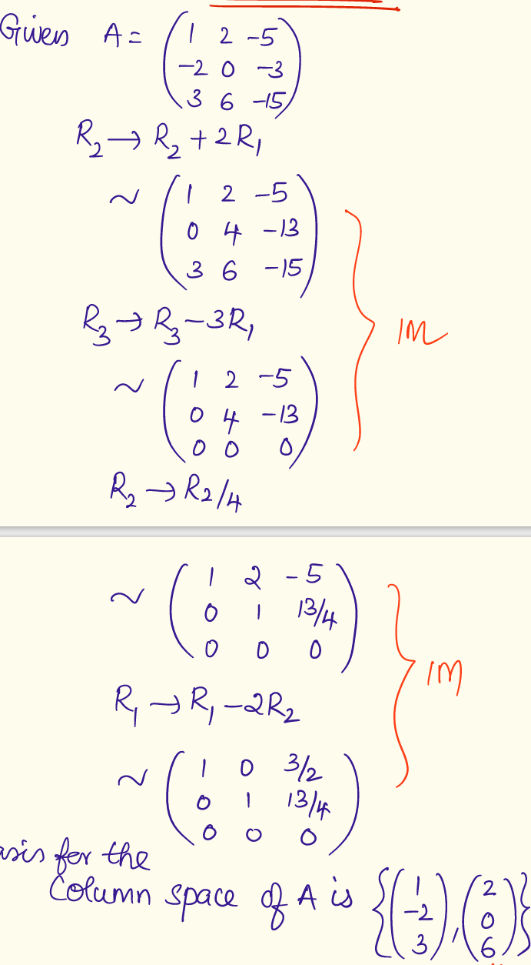
Example

Slide 47
Example

Slide 48
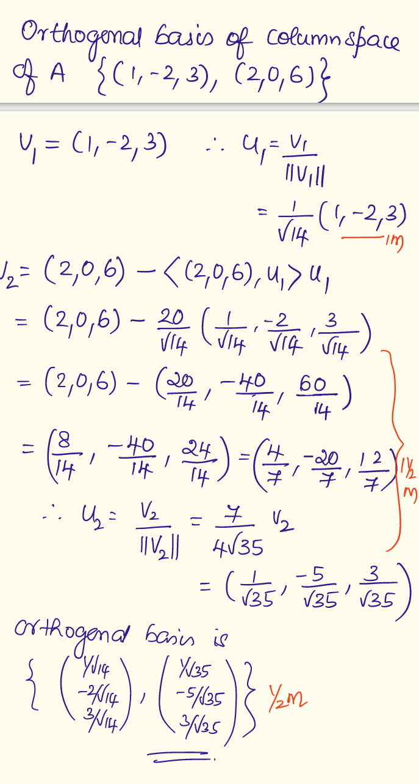
Example

